Slide 1
The Fifth Tokyo International Conference on African Development（TICAD V）
～Hand in Hand with a More Dynamic Africa～
June 1 to 3, 2013, in Yokohama, Japan

Slide 2
About TICAD
TICAD stands for “Tokyo International
Conference on African Development.” In 1993, Japan launched TICAD to promote high-level policy dialogue between African leaders and development partners on issues facing Africa, such as economic development, poverty and conflict.
TICAD has since evolved into a major global framework to facilitate the implementation of measures for promoting African development under the dual principles of African “ownership” and international “partnership.”
TICAD is co-hosted by the Government of Japan, the African Union Commission (AUC), the United Nations Office of the Special Advisor on Africa (UNOSAA), the United Nations Development Programme (UNDP) and the World Bank.
TICAD’s stakeholders include all African countries and development partners including international/regional organizations, donor nations, Asian countries, the private sector and civil society organizations.
Since its inception, Japan has hosted the summit-level conference every five years. The fifth conference (TICAD V) will be held in Yokohama, Japan, on June 1-3, 2013.
TICAD aims to mobilize the wisdom and resources of all stakeholders interested in African development under the concept of African “ownership” and “partnership” between Africa and the international community.

Slide 3
The TICAD Process
The objectives of TICAD are two-fold:
(1) promote high-level policy dialogue between African leaders and their partners; and
(2) mobilize support for African-owned development initiatives.
Since Japan hosted the first conference in 1993, a summit-level conference has been held in Japan once every five years.
TICAD I in 1993
TICAD II in 1998
TICAD III in 2003
At the first conference (TICAD I), the co-organizers pledged to reverse the decline in development assistance for Africa that had followed the end of the Cold War.
Participants adopted the Tokyo Declaration on African Development, committing to the pursuit of political and economic reforms in Africa, increased private sector development, regional cooperation and integration, and the harnessing of Asian experience for the benefit of African development.
The second conference (TICAD II) addressed Africa’s development challenges with poverty reduction and the integration of Africa into the global economy as a primary themes.
The Tokyo Agenda for Action (TAA) outlined a framework of cooperation in the TICAD process identifying shared goals, objectives and guidelines for actions to be taken by Africa and its partners.
TICAD II also advocated the dual principles of TICAD: ownership by Africa and partnership with the international community.
The third conference (TICAD III) made an explicit commitment for the TICAD Initiative to support the African Union’s New Partnership for Africa’s Development (NEPAD), which is a blueprint for Africa’s peace and socio-economic growth and development.
The TICAD 10th Anniversary Declaration, an outcome statement that renewed the commitment of leaders for African development, was adopted at the conference, placing special emphasis on the concept of human security.
TICAD IV in 2008
Aiming for a vibrant Africa, TICAD IV addressed the following three priority areas: (1) Boosting economic growth; (2) Ensuring “human security,” including the achievement of the Millennium Development Goals (MDGs) and the consolidation of peace and good governance; and (3) Addressing environmental issues and climate change.
TICAD IV was attended by approximately 3,000 delegates, including 41 African heads of state.
The Yokohama Declaration, confirming political commitment towards African development, was adopted. The Yokohama Action Plan that outlines measures to be implemented for the next five years and the TICAD Follow-Up Mechanism to monitor the implementation of the action plan were also introduced.
Since the introduction of the TICAD Follow-Up Mechanism, the TICAD Ministerial Follow-Up Meeting has been held in African countries every year, specifically 2009 in Botswana, 2010 in Tanzania, 2011 in Senegal and 2012 in Morocco.

Slide 4
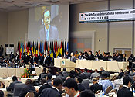
Japan’s Commitments and Achievements
Japan’s Commitments made at TICADⅣ in 2008
【Doubling ODA to Africa】
Double Japan’s ODA to Africa by 2012 to US$1.8 billion (and Provide ODA loan of up to US$4 billion in five years (mainly in infrastructure and agriculture)
【Providing support for doubling Japan’s direct investment in Africa】
Support doubling Japan’s private direct investment up to US$3.4 billion by 2012 (Japan Bank for International Cooperation (JBIC) established a fund to this end)
Japan has made steady progress in its commitments set forth at TICAD IV.
Almost all targets, including the doubling Japan’s Official Development Assistances (ODA) and direct investment to Africa, have been achieved.
Doubling Japan’s ODA
Doubling Japan’s Direct Investment in Africa
End of Year | 2002-2006 | 2003-2007 | 2004-2008 | 2005-2009 | 2006-2010 | 2007-2011 | 2008-2012
US$ billion | 1.7 | 2.3 | 3.3 | 4.2 | 5.2 | 6.2 | 3.4
Source: MOFA Japan
Source: JETRO

Slide 5
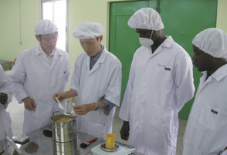
Japan and Africa, Public and Private Partnership
Private investment plays a vital role in promoting sustainable and quality growth in Africa. The following examples show how Japan has combined the technologies, knowledge and experience of the private sector with its ODA to Africa.
2. Inclusive and Resilient Society
Improving the nutrition of children in Ghana through Ajinomoto’s “KOKO Plus”
1. Robust and Sustainable Economy
In Ghana, the main meal for children during the weaning period is a traditional porridge made with fermented corn known as koko. However, this food is deficient in energy, protein and micronutrients, making it one of the major causes of growth retardation among children in the country.
Ajinomoto has leveraged its technology and know-how in food processing and amino acid nutrition to develop “KOKO Plus,” a nutritional supplement to tackle poor nutrition among children. JICA is providing assistance to develop a business model and business plan for Ajinomoto’s nutritional supplements in Ghana.
Collaboration between ODA and Komatsu at Senegal-Japan Vocational and Technical Training Center (CFPT)
Senegal is lacking experienced technicians, particularly in the fields of public works, road construction and logistics. Since 1982, the Japan International Cooperation Agency (JICA) has been supporting the establishment and operation of the Senegal-Japan Vocational and Technical Training Center (CFPT), which has produced approximately 2,300 graduates.
Komatsu Ltd. set up the Komatsu Dakar Training Center (KDTC) in Dakar, Senegal, in 2009, and has been developing human resources for its distributors in Africa.
JICA and Komatsu Ltd. collaborate in supporting the implementation of a heavy machinery maintenance course that CFPT started in 2012. Komatsu Ltd., with the cooperation of its local distributor, not only provides training to CFPT instructors at KDTC but also sends KDTC instructors to CFPT to provide training to CFPT trainees utilizing its facilities and equipment.
3. Peace and Stability
Providing training to CFPT trainers at KDTC (Photo: Kiyoshi Yotoriyama/JICA)
Landmine removal in Mozambique and Angola using demining equipment of Yamanashi Hitachi Construction Machinery
A large number of landmines left behind after civil strife in Angola and Mozambique obstruct national development. Demining equipment, made by Yamanashi Hitachi Construction Machinery Co., Ltd., supports mine removal activities in both countries. The demining equipment boasts exceptional safety, durability and mine removal capability.
Japan has delivered two units of the company’s equipment to Angola with ODA funding (currently 12 machines in use) and one to Mozambique with counterpart funds. Yamanashi Hitachi Construction Machinery also provides technical assistance to recipient countries, both by inviting their engineers to Japan for training and sending Japanese engineers to localities.
Demining equipment in operation in Angola (Photo: by Yamanashi Hitachi Construction Machinery Co., Ltd.)

Slide 6
TICAD V: Hand in Hand with a More Dynamic Africa
Africa enjoys remarkable economic growth.
However, Africa still faces challenges such as:
Dependence on commodity trade
Widening income disparities
Recurring conflicts and instabilities
Transformation for Quality Growth
-Taking specific actions based on the following three perspectives-
Robust and Sustainable Economy
Inclusive and Resilient Society
Peace and Stability
To overcome these challenges
Main Messages for TICAD V in 2013 （to be reflected in the outcome documents: the Yokohama Declaration 2013 and the Yokohama Action Plan 2013-2017）
Emphasis on public-private partnership (PPP) and the role of the private sector
Priority Areas: (1) infrastructure, (2) agriculture, and (3) human resources development
Promotion of human security, emphasis on empowerment of women and youth, taking leadership in establishing the post-2015 development agenda （health, education, food security, disaster reduction, and etc.）
Supporting African initiatives for peace and stability
Japan’s assistance measures to Africa
①For “Robust and Sustainable Economy”: Promotion of economic growth through public-private partnership (PPP): supporting infrastructure development and human resources development
②For “Inclusive and Resilient Society”: Contribution to achieving MDGs and providing assistance to Africa based on the discussions for the post-2015 development agenda
③For “Peace and Stability”: Support for Africa’s peace building capacity through human resources development including international counter-terrorism, counter-piracy, and governance, and contribution to the UN Peace Keeping Operation (PKO)

Slide 7
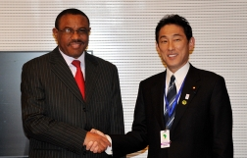
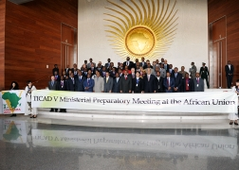
(Reference 1)
Overview of TICAD V Ministerial Preparatory Meeting
TICAD V Ministerial Preparatory Meeting was held on March 16-17, 2013, in Adis Ababa, Ethiopia. Japanese Foreign Minister Fumio Kishida and Ethiopian Foreign Minister Tedros Adhanom served as co-chair of the meeting.
More than 1000 people participated in the meeting including, 46 ministerial-level delegates from 52 African countries, representatives from 84 regional and international organizations, non-governmental organizations and the private sector.
Main Outcome
Japan expressed its commitment to providing assistance to the amount of about US$550 million in order to ensure peace and stability in Africa, which are important foundations for growth and prosperity in Africa.
Participants discussed drafts of the Yokohama Declaration 2013 and the Yokohama Action Plan 2013-2017 that will be adopted at TICAD V. These outcome documents were later approved by the participating ministers.
Participants stressed that expansion of trade and investment would contribute to economic growth led by the private sector. It was confirmed that the Japanese business community would make a possible contributions to three areas – (1) infrastructure development, (2) establishment of a favorable business environment, and (3) development of human resources - with the aim of vitalizing trade and investment in Africa.

Slide 8
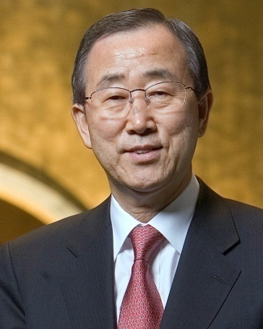
(Reference 2) Voices from the World on TICAD
H.E. Mr. Ban Ki-moon
Secretary-General of the United Nations
“The Tokyo International Conference on Africa’s Development has served as an important framework for raising awareness and galvanising international cooperation. I thank the Government of Japan for its leadership. As a co-organiser of the TICAD process, the United Nations is proud to support this important forum. As leaders gather in the beautiful city of Yokohama for TICAD V, let us celebrate the many gains Africa has made while staying focused on the challenges that remain. Together, let us continue to strengthen partnerships to advance prosperity and peace for all the people of Africa.”
Bono
Lead singer of U2 and co-founder of ONE and (RED)
“Konichiwa! At TICAD IV in 2008 Japan made a commitment to double bilateral aid to Africa by 2012. Delivery on that promise is on track, despite unimaginably tough times after the tsunami, and has helped support African leadership through an incredible decade of progress. This shows great vision on behalf of the Japanese people, who alongside TICAD and Japan have a critical role to play in making the lives of the poorest of the poor more than a bit better.”

Slide 9
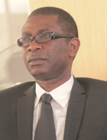
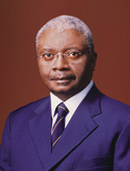
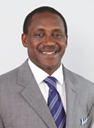
(Reference 2) Voices from the World on TICAD
H.E. Mr. Youssou Ndour
Minister for Tourism and Leisure of Senegal
“Africa enjoys enormous benefits from TICAD. Japan supports the essential sectors of education and human resource development, greatly contributing to capacity building and technology transfer in Africa.”
H.E. Mr. Armando Emílio Guebuza
President of the Republic of Mozambique
“The TICAD Process has shown a great impact on African development since its commencement in 1993, particularly in the areas of infrastructures, logistics, agriculture, education and health.”
Dr. Kandeh K. Yumkella
UNIDO Director-General and Special Representative for the UN Secretary-General
for the Sustainable Energy of All Initiative
“I remain very optimistic about the future of Africa’s development, but the continent’s renaissance will depend on political will and on making the right choices. Africa can realize its economic potential if Africans take the lead in defining the post-2015 development goals and ensure that private sector wealth and job creation are at the core of the new agenda. I am certain that TICAD V, as a universal institution, will help catalyze the decisions that will ensure that Africa’s economic needs are recognized as a matter of global concern.”

